Slide 1
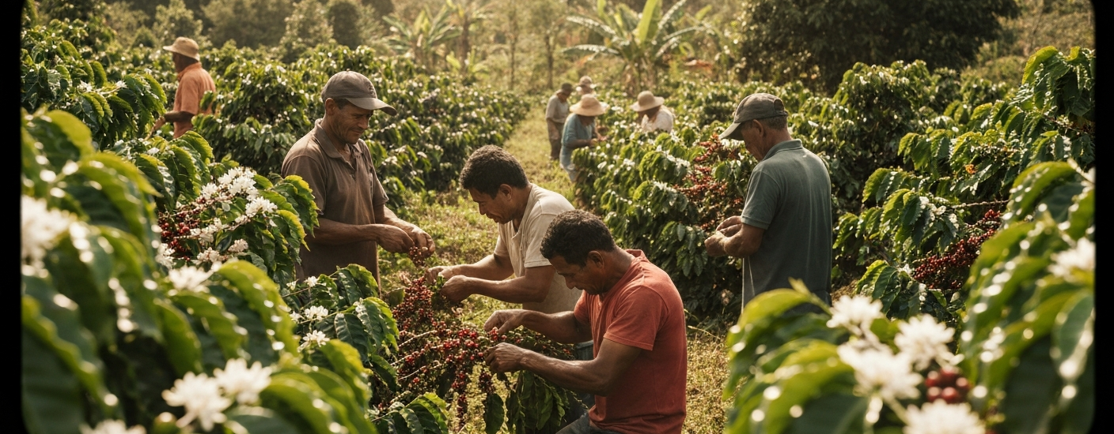
Decarbonizing the Global Coffee Value Chain
Explore the challenges and opportunities in decarbonizing the global coffee value chain to protect livelihoods, meet consumer expectations, and build a more sustainable future.

Slide 2

Overview of the Coffee Value Chain
Global Coffee Value Chain
Mapping Key Risks and Impacts
Driving Sustainable Transformation
Comprehensive overview from farm to cup, covering key aspects of the industry
Highlighting risks, vulnerabilities, and environmental/social impacts across the value chain
Identifying actions and interventions needed to build a more sustainable coffee sector
A deep dive into the global coffee value chain to understand the complex challenges and drive positive change towards a more sustainable future for the industry.

Slide 3

Origin Regions and Production
The global coffee production is concentrated in the 'Bean Belt' region between 25°N and 25°S latitudes, with the top five producing countries accounting for over 73% of the world's coffee supply. Brazil, the leading producer, is known for its arabica-dominant output, while Vietnam specializes in robusta beans. The coffee industry is largely dominated by smallholder farmers, who play a crucial role in shaping the sustainability of the global coffee value chain.

Slide 4


Farm Economics and Costs
Cost Component
Cost per kg (USD)
Field labor (pruning, harvest)
$1.10
Inputs (fertilizer, IPM)
$0.60
Processing (wet/dry, parchment loss)
$0.25
Transport to mill/market
$0.15
Compliance/admin/fees
$0.05
Finance (interest/working capital)
$0.08
*Global Coffee Value Chain Sustainability presentation

Slide 5
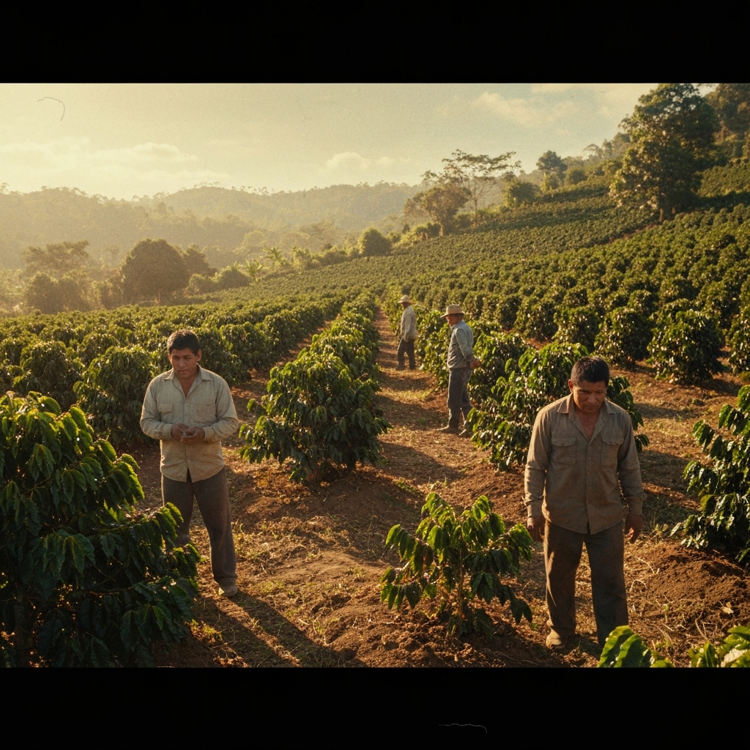
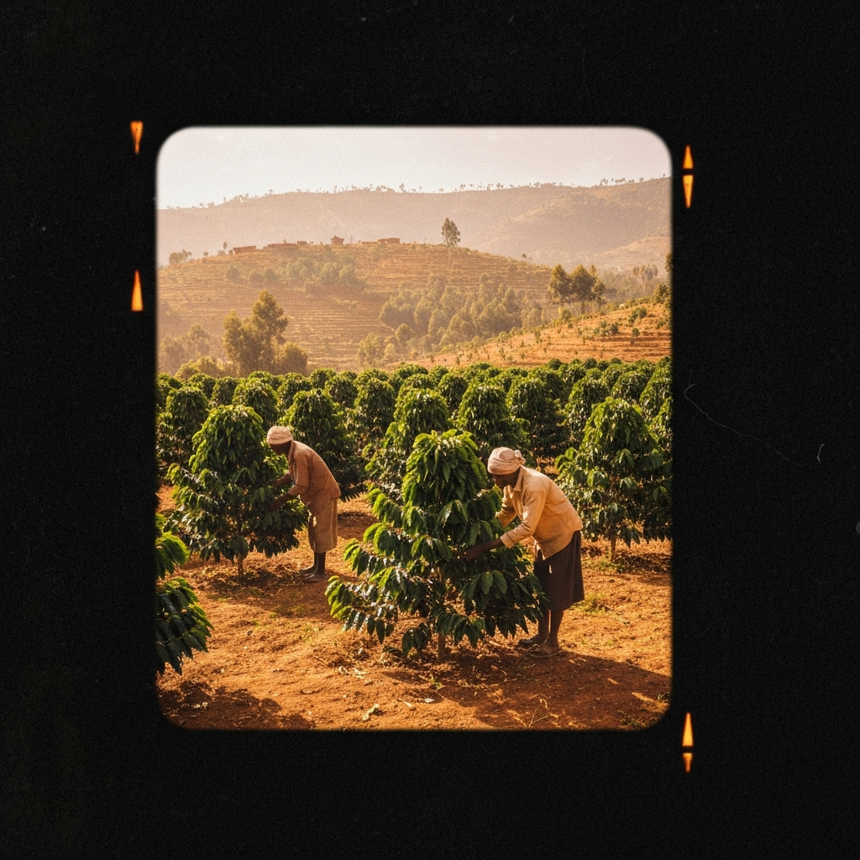
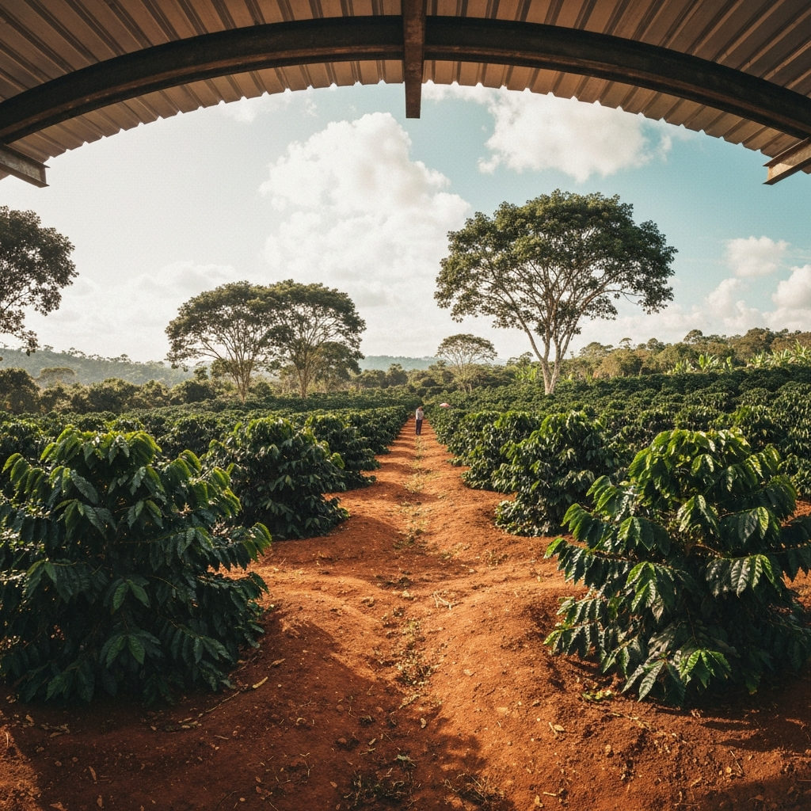
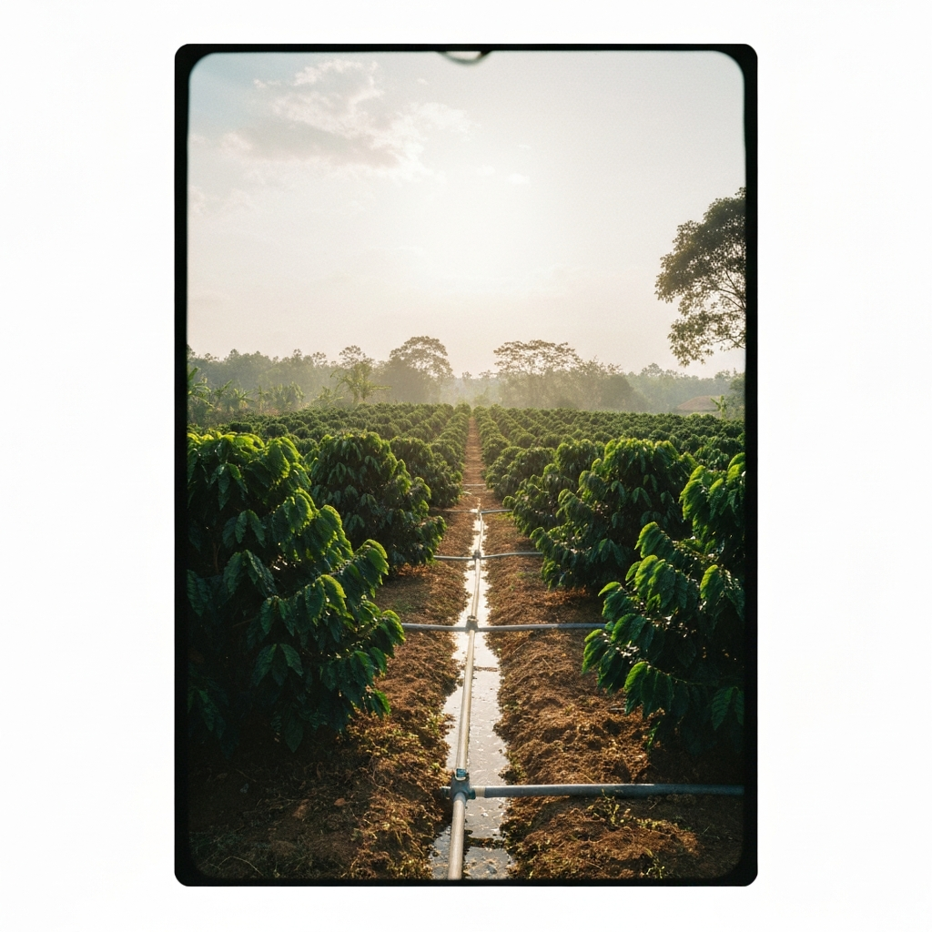
Climate Risks and Hotspots
Central America Coffee Crisis
Ethiopia Highlands Climate Migration
Brazil's Minas Gerais Challenges
Vietnam Water Scarcity
Water scarcity, challenging the heat tolerance of robusta varieties
Risks of coffee leaf rust resurgence and drought, with significant suitability loss by 2050
Suitability migration upslope, posing biodiversity trade-offs
Heat waves, irregular rainfall, and rising irrigation demand

Slide 6








Coffee Processing and Logistics
The harvested coffee cherries are processed through wet milling, where the fruit pulp is removed and the beans are fermented and washed to remove the mucilage.
The coffee beans are then dried, either using traditional sun-drying methods or mechanical drying, to reduce the moisture content to around 11-12%.
Coffee cherries are harvested from smallholder farms, typically in tropical regions near the equator (the 'Bean Belt').
The dried beans undergo dry milling, where the parchment and silver skins are removed, and the beans are sorted by size, density, and quality.
The green coffee beans are exported, often through major ports, to consuming countries around the world.
The green coffee beans are transported by ocean freight, a major energy-intensive step in the supply chain.
Farm
Wet Milling
Drying
Dry Milling
Exporting
Ocean Freight
Importing
Roasting
Packaging
Distribution
Brewing
The green coffee is imported into the consuming countries, often through major ports.
The green coffee beans are roasted, a highly energy-intensive process that transforms the physical and chemical properties of the beans.
The roasted coffee is packaged, often in bags or pods, for distribution to retailers and consumers.
The packaged coffee is distributed to retail outlets, such as grocery stores, cafes, and online platforms.
At the consumer level, the coffee is brewed, either at home or in a commercial setting, which also requires energy consumption.

Slide 7
Certification Landscape
Estimated market share of major sustainability certification schemes in the coffee industry
52%
13%
8%
6%
23%
Rainforest Alliance / UTZ
4C
Organic
Fairtrade
Uncertified / Other

Slide 8







Retail Margin Breakdown
Retailer Margin
Roaster Net Margin
Farmer's Net Share
Other Costs

Slide 9
Key Takeaways
Smallholder farmers dominate coffee production
Smallholder farmers account for the majority of global coffee production, facing narrow profit margins and vulnerability to climate risks.
Climate change poses significant threats
Rising temperatures, rainfall variability, and increased pest/disease pressure threaten coffee production in key regions like Central America, Ethiopia, and Vietnam.
Limited market coverage of sustainability certifications
While major certification schemes like Fairtrade and Rainforest Alliance exist, their market coverage remains below 25%, with a significant portion of uncertified coffee.
Disproportionate value distribution
The retail margin breakdown shows that the majority of the final price does not reach the farmer, highlighting the need for a more equitable distribution of value.
High-impact interventions across the value chain
Opportunities exist to decarbonize the value chain through agroforestry, precision farming, water recycling, efficient roasting, and sustainable packaging.

Slide 10
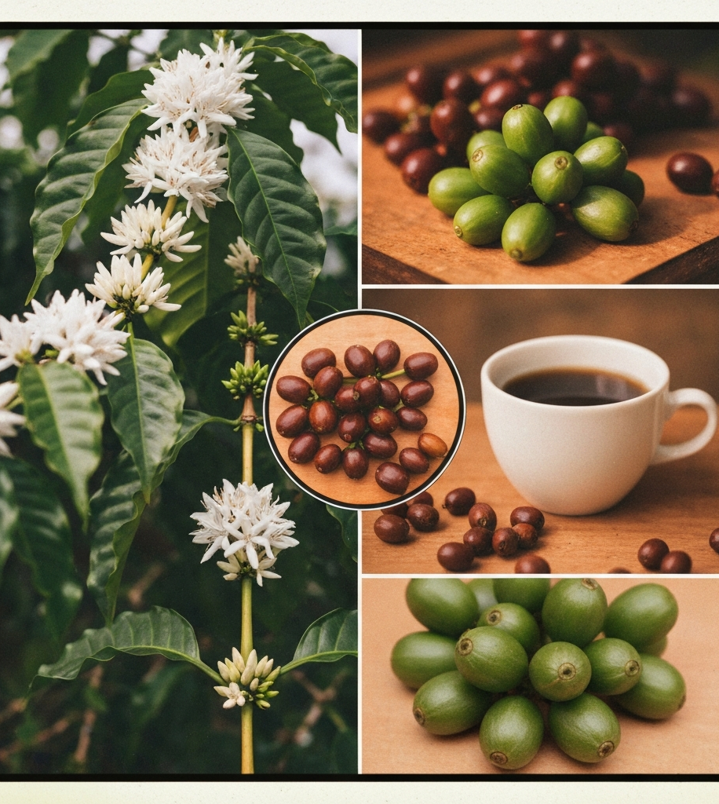
The coffee industry faces significant sustainability challenges, from climate risks to narrow farmer margins. However, by adopting holistic solutions across the value chain, we can build a more resilient and equitable future for coffee production and consumption. Key actions include investing in climate-smart agriculture, improving supply chain transparency, and empowering smallholder farmers to thrive.

